Slide 1

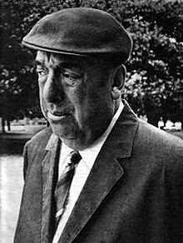
KEEPING QUIET
Pablo Neruda

Slide 2
PABLO NERUDA
Pablo Neruda was the pen name and, later, legal name of the Chilean poet-diplomat and politician Neftali Ricardo Reyes Basoalto ,born on July 12, 1904 – September 23, 1973).
He derived his pen name from the Czech poet Jan Neruda. He won the Nobel Prize for Literature in 1971.
Neruda became known as a poet when he was 10 years old. He wrote in a variety of styles, including surrealist poems, historical epics, erotically charged love poems such as the ones in his collectionTwenty Love Poems and a Song of Despair (1942).

Slide 3

A BRIEF OUTLOOK
IN THIS POEM ,THE POET VISUALISES A STATE OF COMFORTABLE INERTIA WHERE HE WISHES FOR PLEASANT IDLENESS AND RELAXATION AWAY FROM THE FRANTIC RAT RACE ,DESTRUCTIVE ACTIVITIES AND FUTILE WARS . HE WISHES FOR A PROFOUND SILENCE AND STILLNESS THAT WOULD ALLEVIATE
THE SADNESS
CAUSED AND
BY LACK THE THREAT
OF SELF
OF SELF
UNDERSTANDING
DESTRUCTION AND WHICH WOULD BUILD UP A SENSE OF TOGETHERNESS.

Slide 4
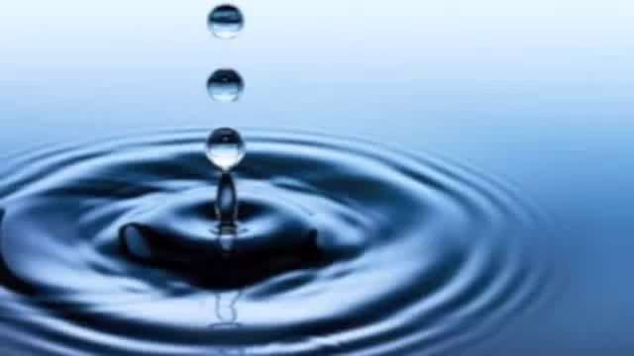
Listen to the Poem

Slide 5
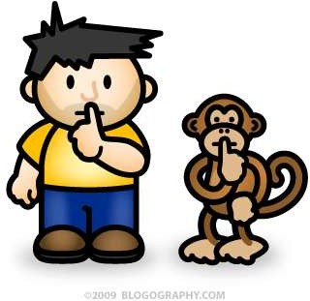
Lets begin the poem
“Now we will count to twelve and we will all keep still.”

Slide 6
The poet begins with counting twelve urging everyone to be still. He chose
‘twelve` for several reasons. ‘Twelve’ hints at the twelve hours of a day which rules our life. ‘Twelve` refers to twelve zodiac signs believed to be the
controlling forces of our lives. ‘Twelve` refers to twelve months of a year and if we believe numerology its the digit of peace and prosperity. ‘Twelve` even may be aimed for a preparation for all to be ready to plunge into the state of silence.
Poetic devices in use
We will = Alliteration (line 1 and 2)
Count ................still – Antithesis
•

Slide 7

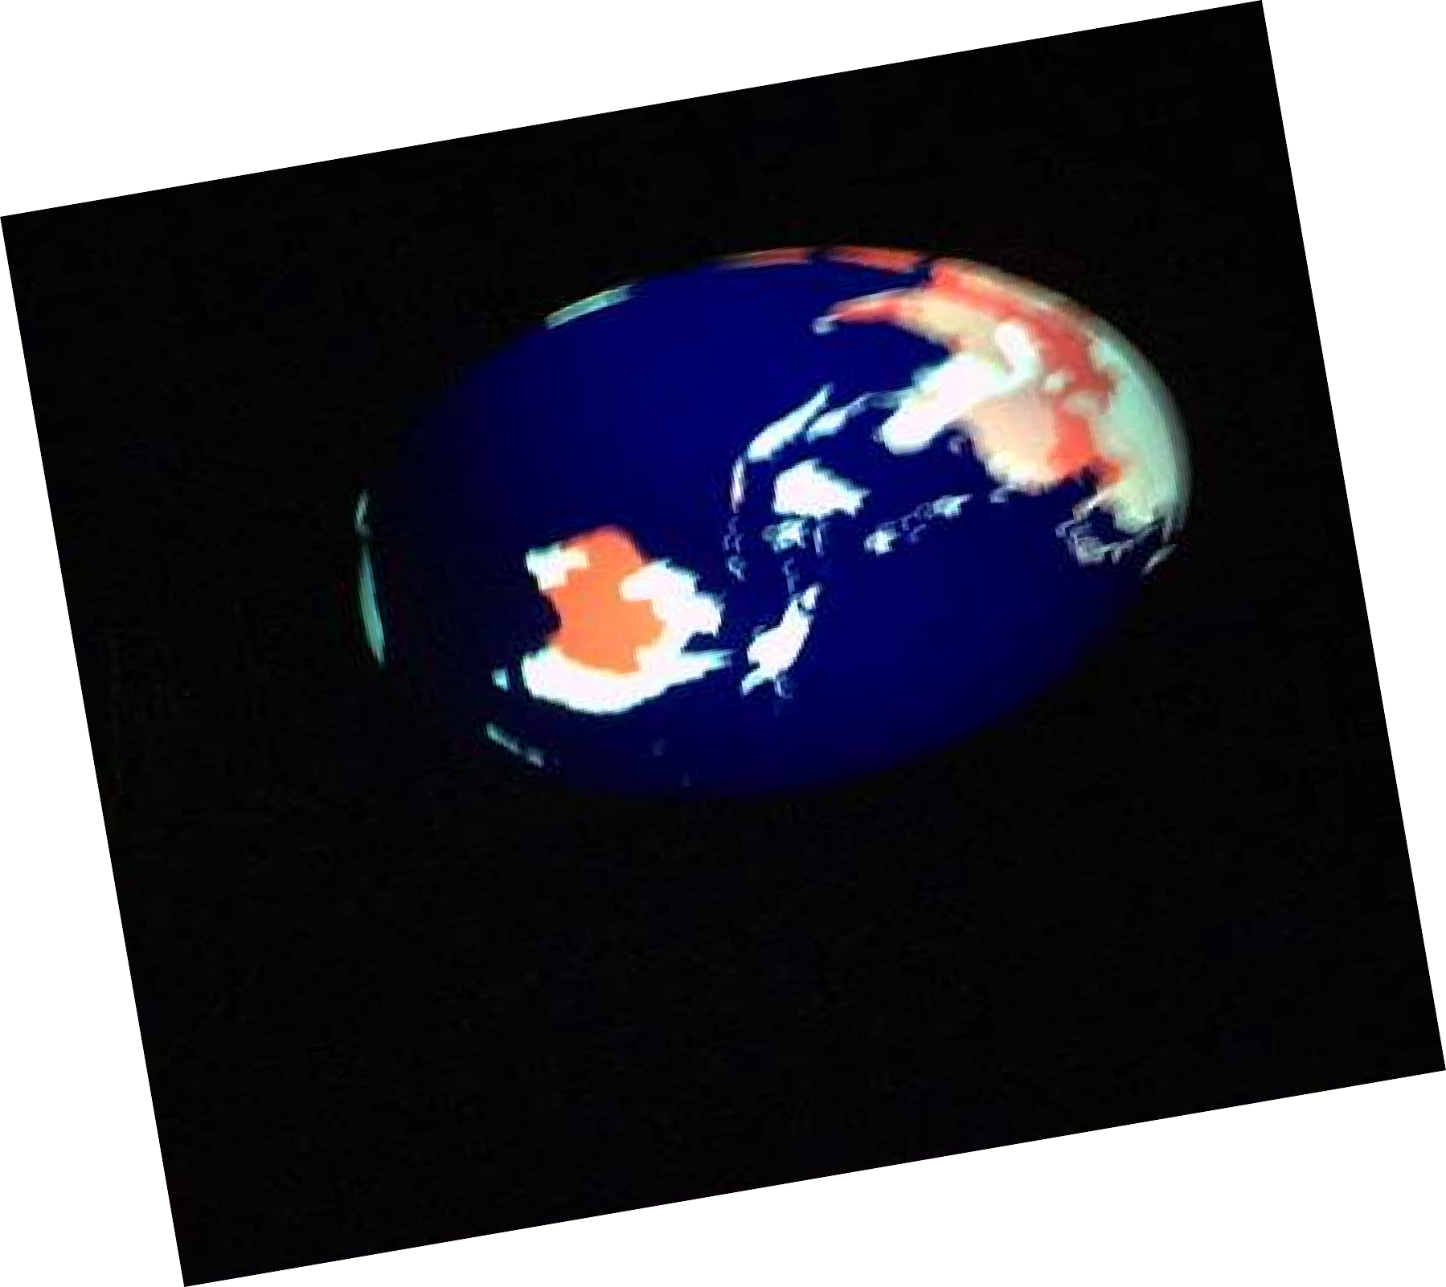
“For once on the face of the earth, let's not speak in any language;”
Let's stop for one second , And not move our arms so much

Slide 8
The poet here urges everyone to break the barriers of language and unite with one invisible tune i.e. silence. With the word ‘earth` the poet hints at all the humans living devoid the identity of country creed and caste. Though language is the identity of a country or race, he affirms that humans are more important and the identity of being a human of earth is broader realization.
Poetic devices in use
1) Once on – Alliteration

Slide 9
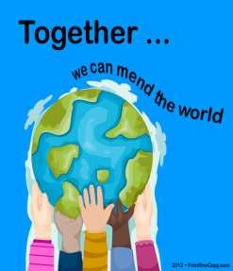
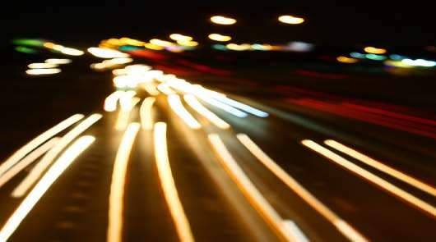

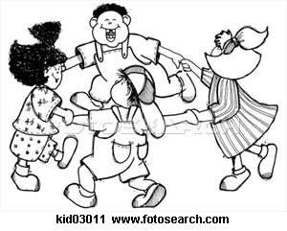

“It would be an exotic moment without rush, without engines;
we would all be together in a sudden strangeness.”

Slide 10
We are always on move. We are all busy in accomplishing our work and go on rushing in our lives. The poet even urged to stop engines (referring industrial works causing harms to environment) . The poet urges us to stop our personal activities and stop engines and unite in one tune i.e. silence. The poet declares silence as exotic because this silence will make us blissful, strange and will bring complete equilibrium.
Poetic devices in use
Without .................without – Repetition
We would – Alliteration.
Sudden strangeness – Alliteration

Slide 11
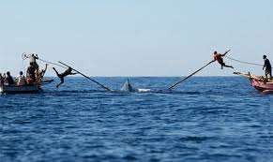
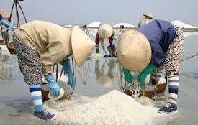
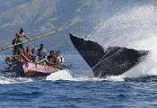
“Fisherman in the cold sea would not harm whales
and the man gathering salt would look at his hurt hands.”

Slide 12
`If we be still, we shall be able to introspect the mistakes and wrongs done. Here fishermen are the representatives of all kinds of tyrants and killers. The poet wants, them to cease their work and realise their
mistakes. The salt gatherer is explained
representative of poor and lower section
as the
of the
society. They go up to any level to earn their livelihood and often hurt themselves irreparably.
Poetic Devices in use
Cold sea – symbolised as polar region
His hurt hands – Alliteration

Slide 13
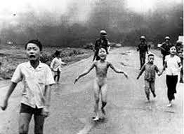
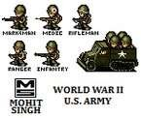
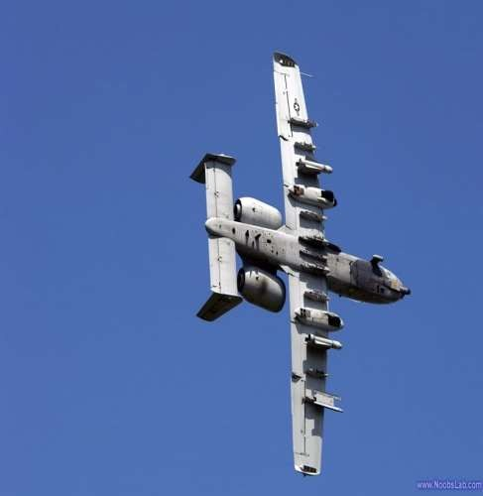
“Those who prepare green wars, wars with gas, wars with fire, victories with no survivors, would put on clean clothes
and walk about with their brothers in the shade, doing nothing.”

Slide 14
The poet here condemns the people with green wars (biological weapon or creators of pollution) and wars with fire (Atomic war) . They become victorious but with no survivors left. The poet mocks at the victory of those people who get victory over destruction. The poet asks them to leave the path of destruction and join the group of silence. He urges them to put on white (symbolising – purity and serenity) clothes. And walk with others doing nothing (meaning - anything negative and doing self introspection)
Poetic devices in use
Wars with – Alliteration
Wars with – Repetition
Clean clothes – Alliteration

Slide 15


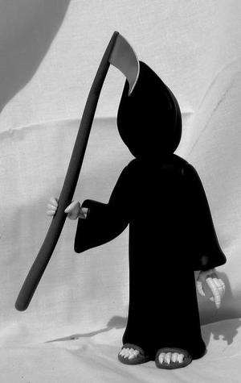
“What I want should not be confused with total inactivity.
Life is what it is about;
I want no truck with death.”

Slide 16
The poet here warns us that his message of silence should not be confused with total inactivity or
inertia. He further clears that his message does not have any affinity with death even. His message is aimed at the way of living. He wants us to stop a while and feel the calmness so that a positive introspection is done.

Slide 17
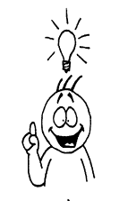
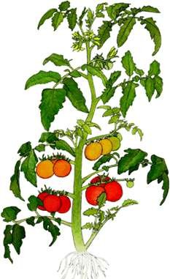
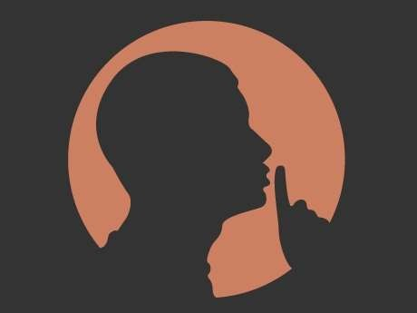

“If we were not so single-minded about keeping our lives moving, and for once could do nothing, perhaps a huge silence
might interrupt this sadness
of never understanding ourselves
and of threatening ourselves with death.
Perhaps the earth can teach us as when everything seems dead and later proves to be alive.”

Slide 18
We human beings are single minded. We are always busy in achieving our goals, completing personal responsibilities. And we never stop a while to evaluate ourselves and understand ourselves. We never understand that we shall never be able to come out of these desires and achievements. If we could stop a while from these using we would have understood the real purpose of our lives and ourselves. Rather we go on with the fear of death calculation how much of our dreams and wishes will be achieved.
Poetic devices in use
1) We were – Alliteration

Slide 19
“Now I'll count up to twelve
and you keep quiet and I will go.”
1
10
2 3
4 5 6 7 8 9
11 12

Slide 20
In conclusion the poet taught us through the example of earth which at one season may look as if dead but comes back with life in another season. Likewise our life will also bear certain meaning when we walk on the right path i.e. introspecting in silence. In the last two lines the poet leaves us to introspect as if he himself has gone through the same.
Poetic device in use – dead ……alive – Antitheses.

